Slide 1
Chinese
New Year

Slide 2
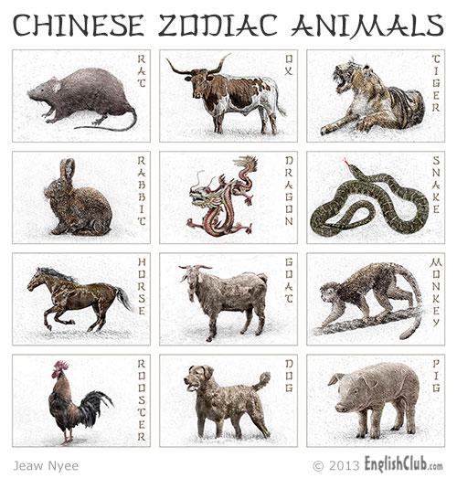
Legend has it that in ancient times, Buddha asked all the animals to meet him on Chinese New Year. Twelve came, and Buddha named a year after each one.

Slide 3
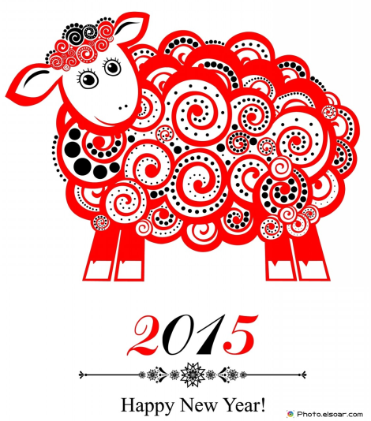
He announced that the people born in each animal's year would have some of that animal's personality.
Chinese New Year 2007 ~The Year of the Red Pig
Chinese New Year 2006 ~ The Year of the Dog

Slide 4
Those born in sheep years are often artistic, charming, sensitive, and sweet. It is known as the most creative sign in the Chinese zodiac

Slide 5
At Chinese New Year celebrations people wear red clothes, decorate with poems on red paper, and give children "lucky money" in red envelopes.

Slide 6
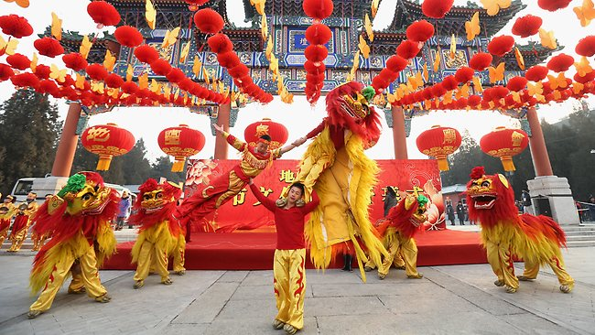
In China, the New Year is a time of family reunion. Family members gather at each other's homes for visits and shared meals, most significantly a feast on New Year's Eve.

Slide 7
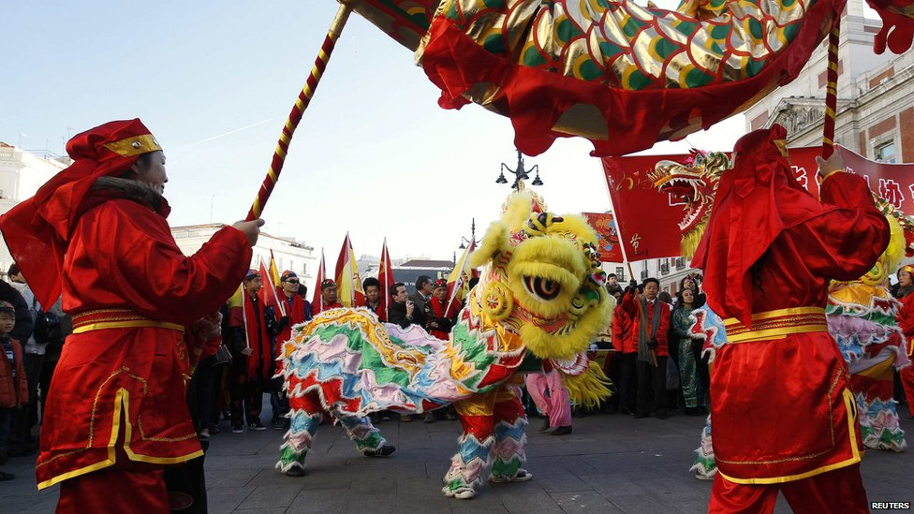
There will be a variety of clowns, stilt walkers, acrobats, floats and parades, music and drums and of course the Chinese Lion and Dragon Dances and firecrackers

Slide 8
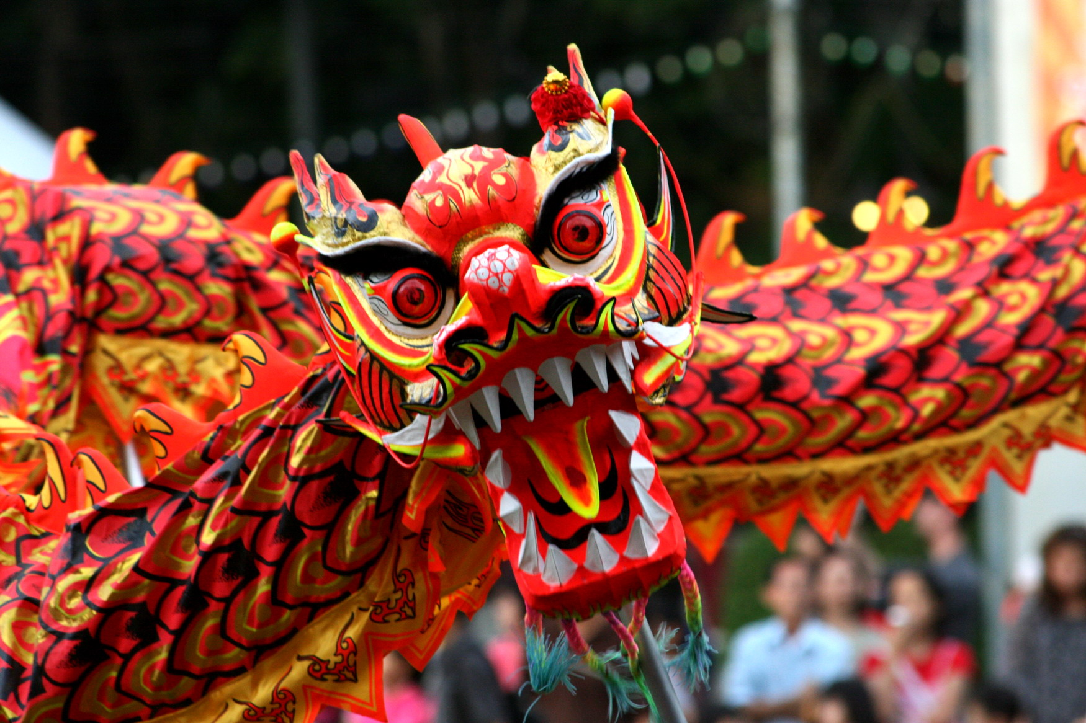
In many areas the highlight of the lantern festival is the dragon dance. The dragon—which might stretch a hundred feet long—is typically made of silk, paper, and bamboo.

Slide 9
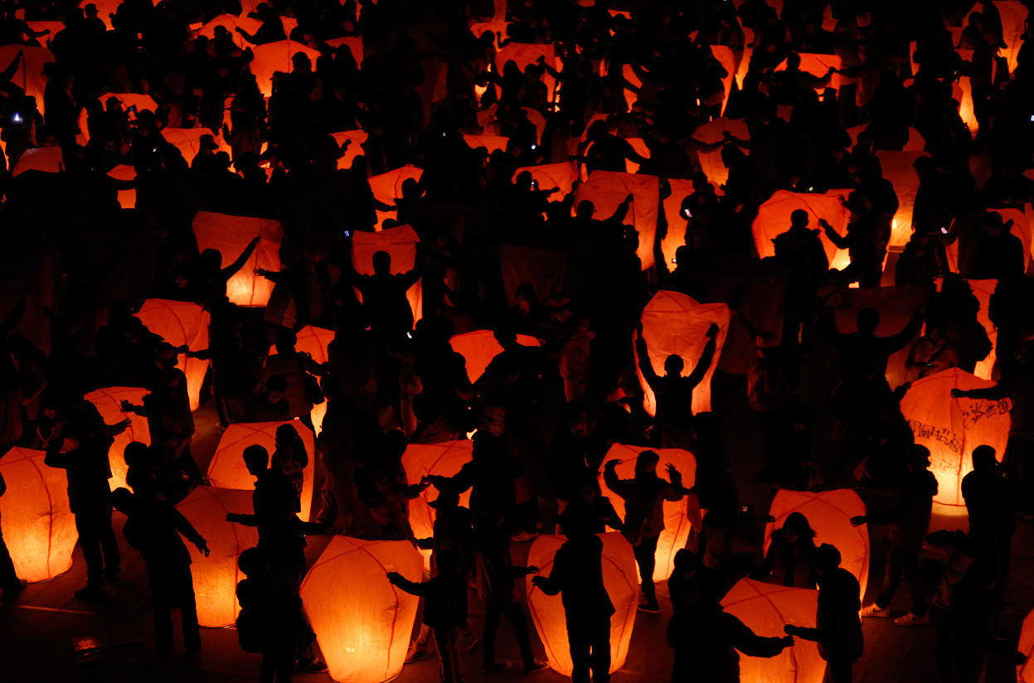
The Lantern Festival marks the end of the Chinese New Year Festivities

Slide 10
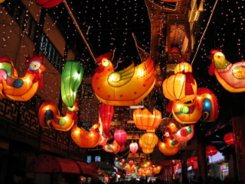
Some of the lanterns may be works of art, painted with birds, animals, flowers, zodiac signs, and scenes from legend and history

Slide 11
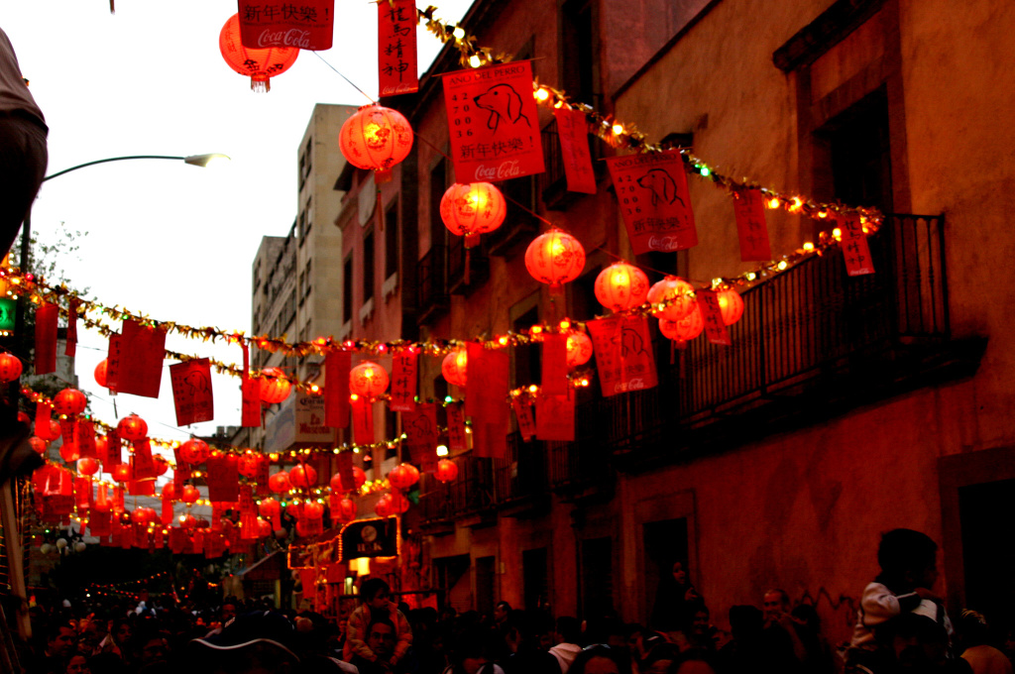
People hang glowing lanterns in temples, and carry lanterns to an evening parade under the light of the full moon.

Slide 12
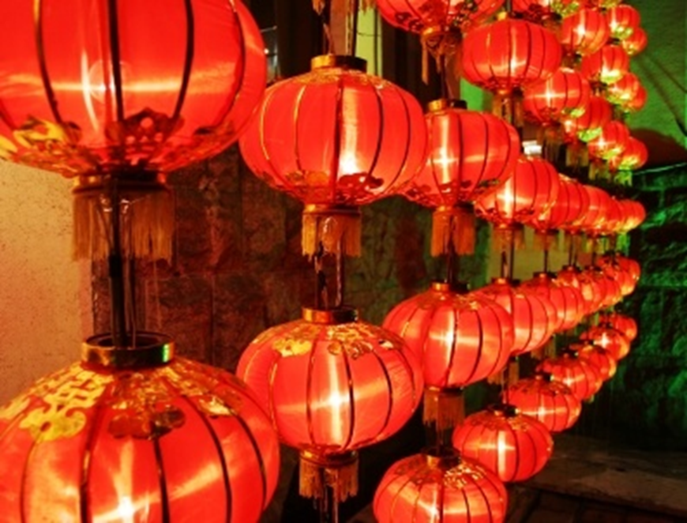
Children carry their lanterns around the village and families come together to eat sweet rice balls for good fortune and family unity.

Slide 13
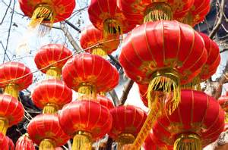
Chinese Lanterns were traditionally made of silk, paper and even glass.

Slide 14
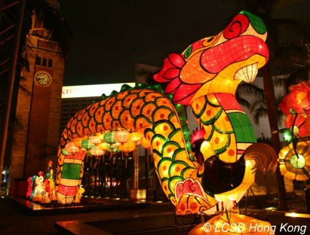
There are lanterns in shapes of boxes, lotus flowers, dragons, butterflies and all sorts of animals.

Slide 15
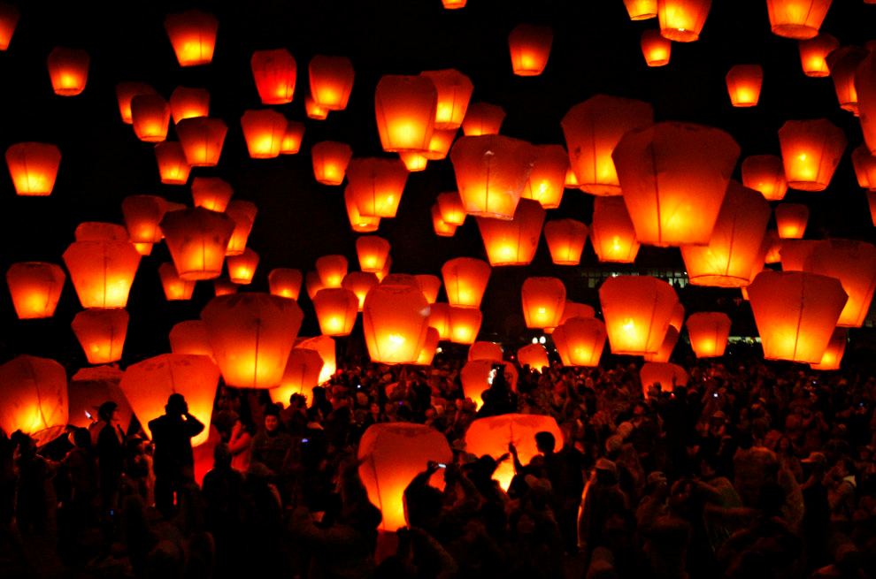
During the night of lantern festival, Some people will fly the sky lantern by writing their wishes on the paper lantern and pray their wishes come true

